Slide 1
C4.5 - pruning decision trees

Slide 2
Quiz 1
Q: Is a tree with only pure leafs always the best classifier you can have?
A: No.
This tree is the best classifier on the training set, but possibly not on new and unseen data. Because of overfitting, the tree may not generalize very well.

Slide 3
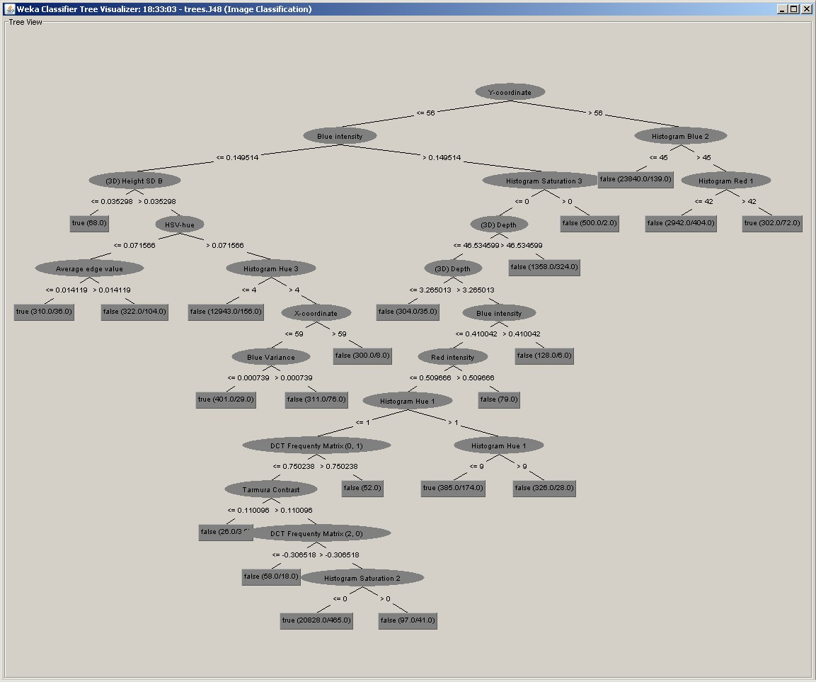

Slide 4
Pruning
Goal: Prevent overfitting to noise in the data
Two strategies for “pruning” the decision tree:
Postpruning - take a fully-grown decision tree and discard unreliable parts
Prepruning - stop growing a branch when information becomes unreliable

Slide 5
Prepruning
Based on statistical significance test
Stop growing the tree when there is no statistically significant dependency between any attribute and the class at a particular node
Most popular test: chi-squared test
ID3 used chi-squared test in addition to information gain
Only statistically significant attributes were allowed to be selected by information gain procedure
Information gain is also a statistical test, but it doesn’t consider the number of examples: two records (TF) can be split with an information gain of 1 bit

Slide 6
Early stopping
 | a | b | class
1 | 0 | 0 | 0
2 | 0 | 1 | 1
3 | 1 | 0 | 1
4 | 1 | 1 | 0
Pre-pruning may stop the growth process prematurely: early stopping
Classic example: XOR/Parity-problem
No individual attribute exhibits any significant association to the class
Structure is only visible in fully expanded tree
Pre-pruning won’t expand the root node
But: XOR-type problems rare in practice
And: pre-pruning pretty fast

Slide 7
Post-pruning
First, build full tree
Fully-grown tree shows all attribute interactions
Then, prune it
Two pruning operations:
Subtree replacement
Subtree raising

Slide 8
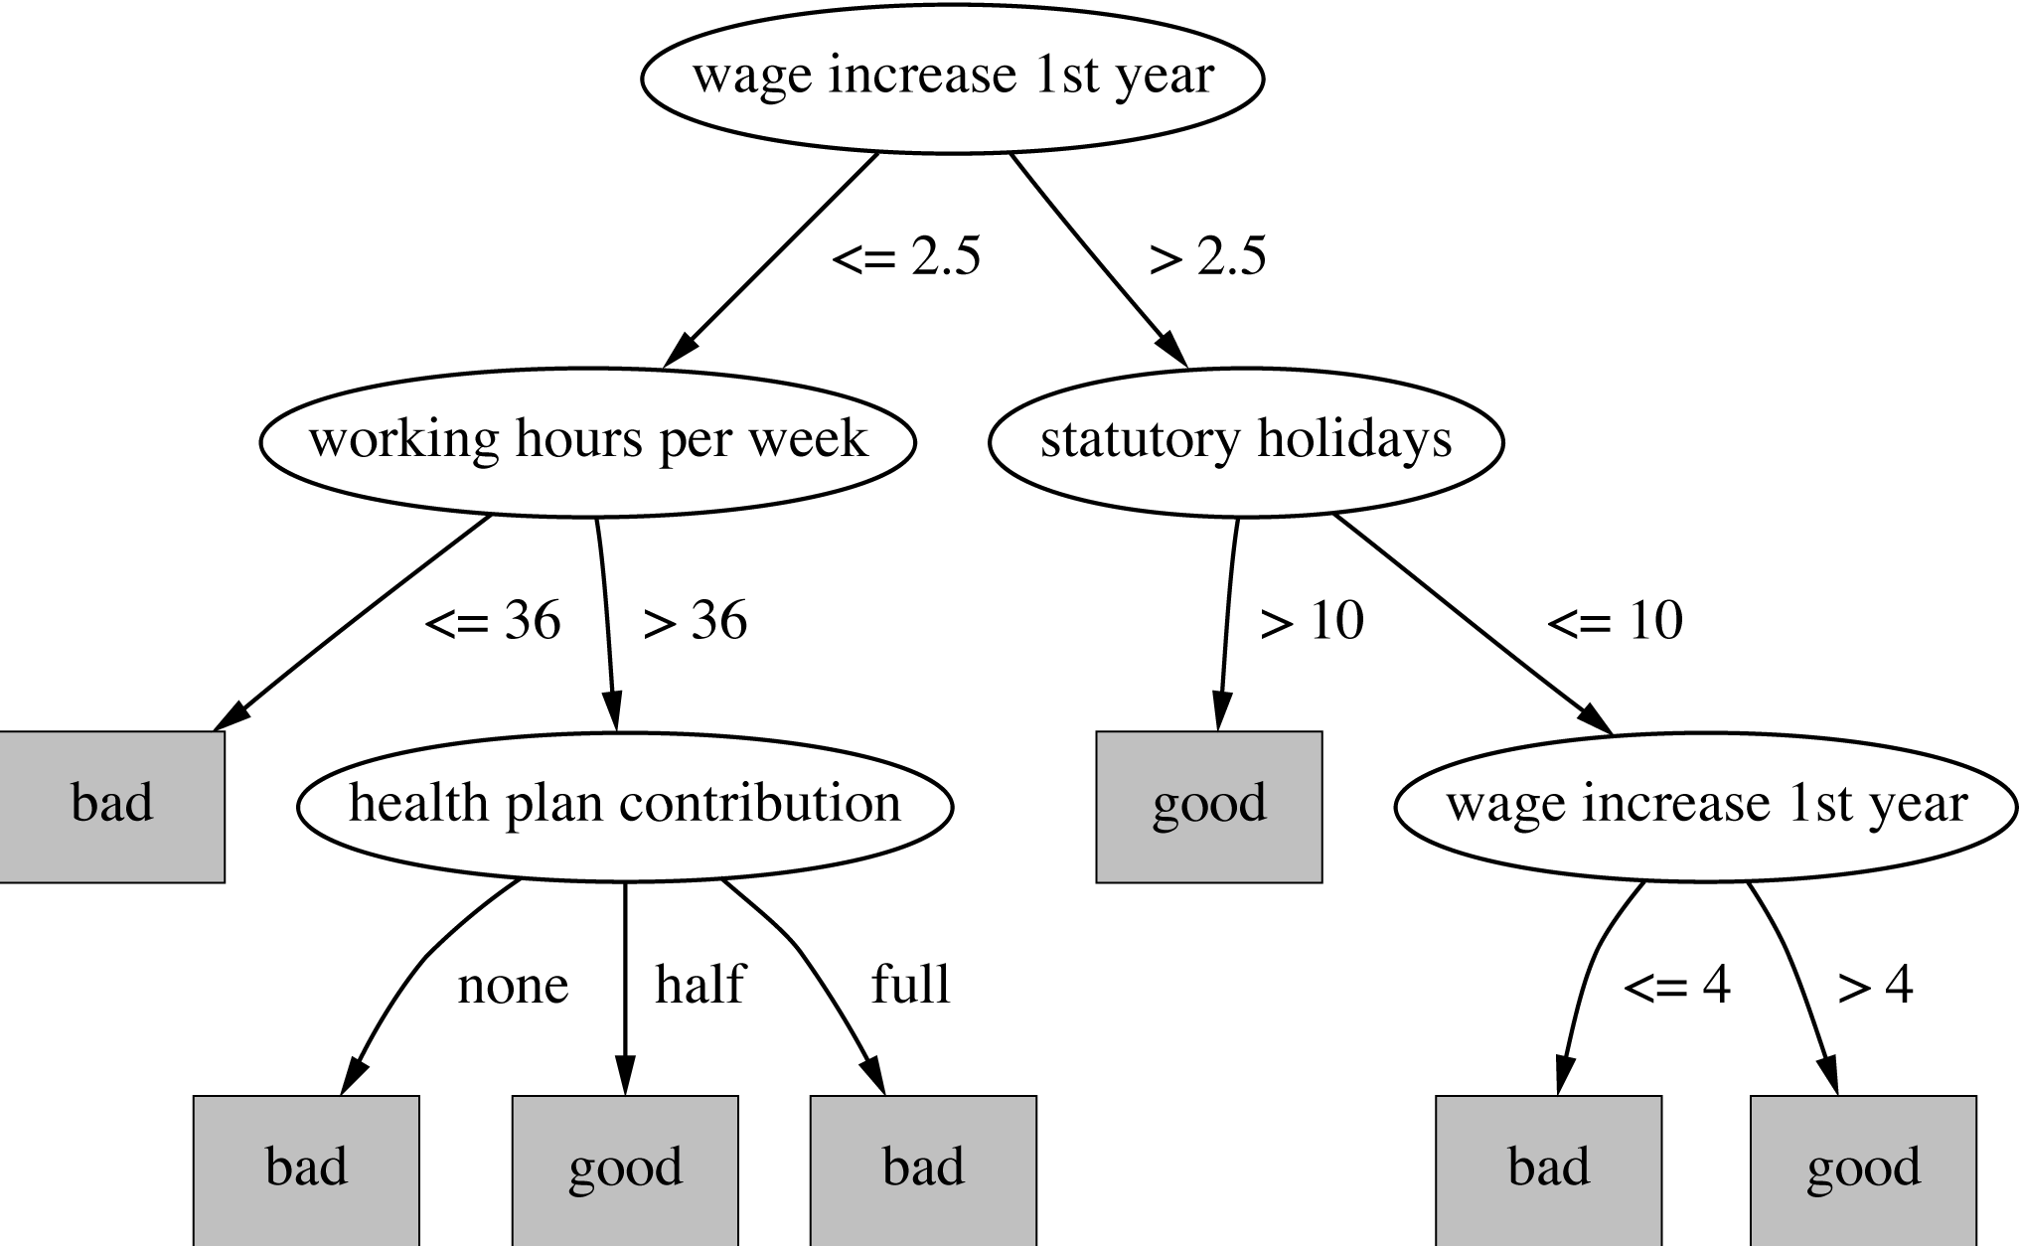
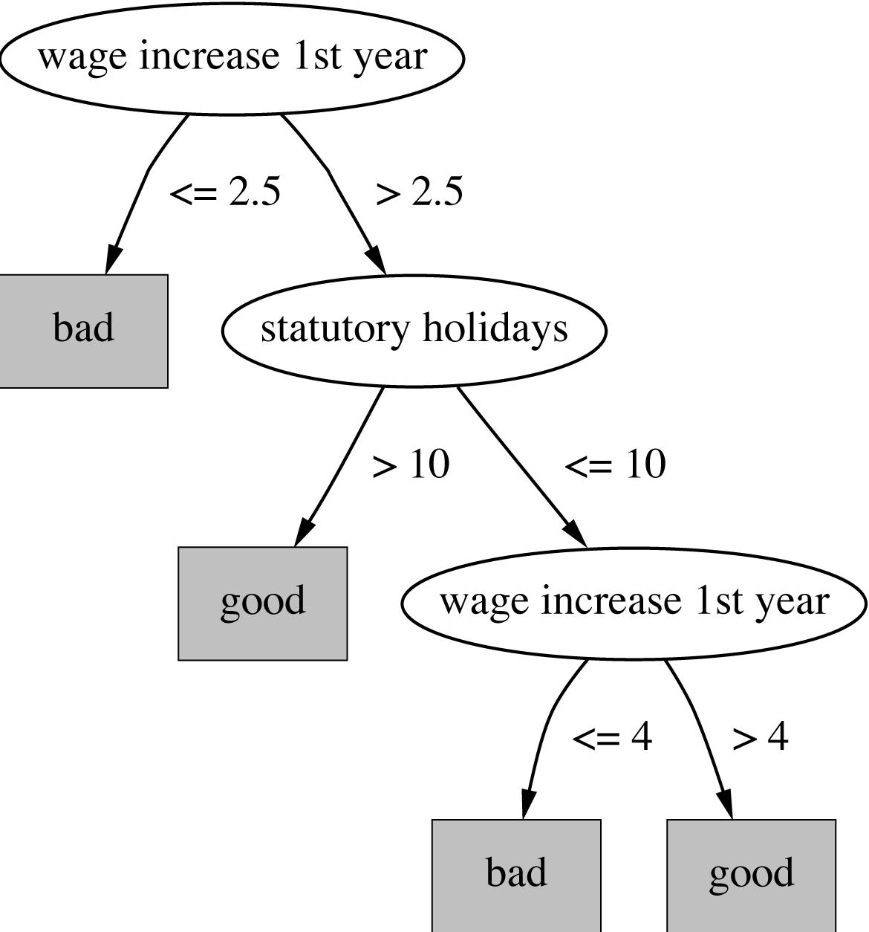
Subtree replacement
Bottom-up
Consider replacing a tree only after considering all its subtrees

Slide 9
Estimating error rates
Prune only if it reduces the estimated error
C4.5’s method
Derive confidence interval from training data
Use a heuristic limit, derived from this, for pruning
Standard Bernoulli-process-based method
Shaky statistical assumptions (based on training data)

Slide 10
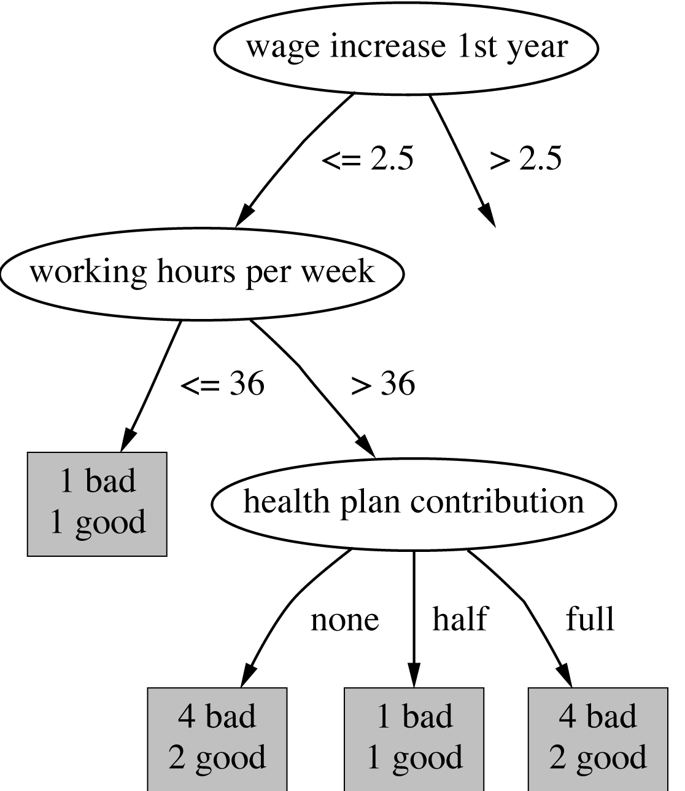
Estimating error rates
Q: what is the error rate on the training set?
A: 0.33 (2 out of 6)
Q: What is the largest error you can get on the training set?
A: 0.5
Q: When you find a pure node, what will the error be on the test set (new data)?
A: Somewhat bigger than 0

Slide 11
Test set error
Two rates
the observed error rate (training set)
the (unknown) actual error rate, will be different (larger?)
Compute confidence interval around observed error rate
Take high end of interval as worst case scenario

Slide 12
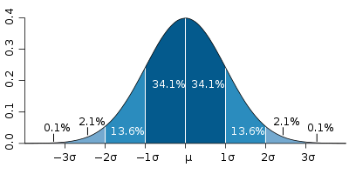
Estimating the error
Assume making an error is Bernoulli trial with probability p
p is unknown (true error rate)
We observe f, the observed error rate f = E/N
For large enough N, f follows a Normal distribution
Mean and variance for f : p, p (1–p)/N
p -σ p p +σ

Slide 13
Estimating the error
c% confidence interval [–z ≤ X ≤ z] for random variable with 0 mean is given by:
With a symmetric distribution:
c

Slide 14
z-transforming f
Transformed value for f : (i.e. subtract the mean and divide by the standard deviation)
Resulting equation:
Solving for p:
-1 0 1

Slide 15
C4.5’s method
Error estimate for subtree is weighted sum of error estimates for all its leaves
Error estimate for a node (upper bound):
If c = 25% then z = 0.69 (from normal distribution)
Pr[X ≥ z] | z
1% | 2.33
5% | 1.65
10% | 1.28
20% | 0.84
25% | 0.69
40% | 0.25

Slide 16
C4.5’s method
f is the observed error
z = 0.69
e > f (not obvious)
e = (f + ε₁)/(1+ ε₂)
N →∞, e = f

Slide 17
Example
f = 5/14=0.36 e = 0.46 e < 0.51 so prune!
f=0.33 e=0.47
f=0.5 e=0.72
f=0.33 e=0.47
Combined using ratios 6:2:6 gives 0.51

Slide 18
Summary
Decision Trees
splits – binary, multi-way
split criteria – information gain, gain ratio, …
pruning
No method is always superior – experiment!

